Slide 1

encryption-decryption
name
Nada sayed
Rawda mahmoud
Esraa elsayed
Shorouk zien

Slide 2

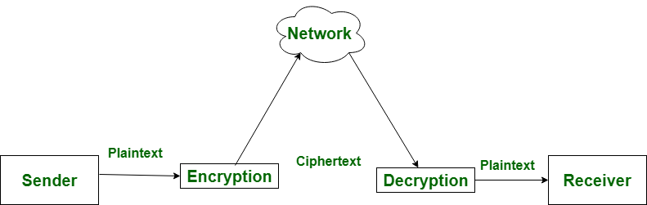
Encryption- Decryption Definition
Encryption is the process of converting normal message (plaintext) into meaningless message (Ciphertext). Whereas
Decryption is the process of converting meaningless message (Ciphertext) into its original form (Plaintext)

Slide 3
Cipher
is an algorithm for performing encryption or decryption
There are a lot type of cipher
We use in our project 2 type
1-MonoNumeric
2-Monoalphabetic

Slide 4
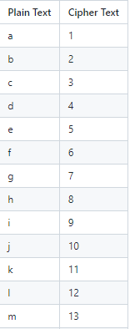
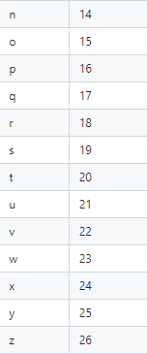
MonoNumeric
In the mono-numeric substitution encryption,
each alphabetic letter isI n the mono-numeric substitution encryption,
each alphabetic letter is substituted by

Slide 5
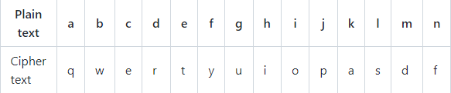
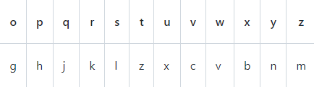
Monoalphabetic:
A mono-alphabetic cipher (aka simple substitution cipher) is a substitution cipher where each letter of the plain text is replaced with another letter of the alphabet. It uses a fixed key which consist of the 26 letters of a “shuffled alphabet”.

Slide 6
Project Phases
1-collecting information
2-learning how work on githup
3-implement code with c then return it to assymbly
4-testing

Slide 7
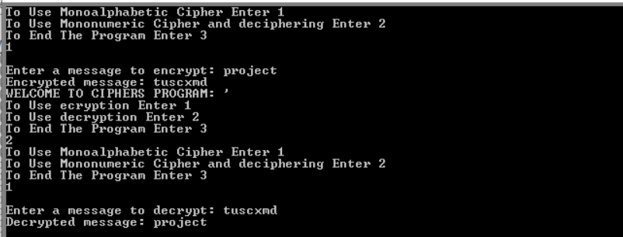
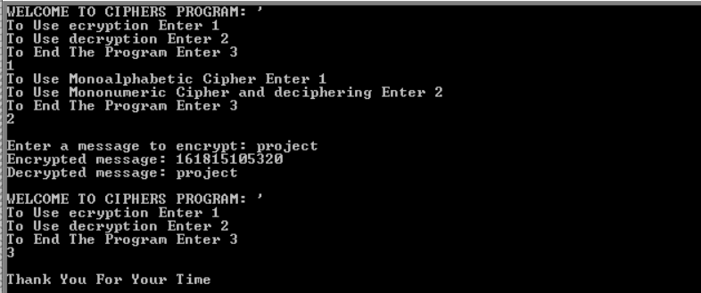
output

